Slide 1
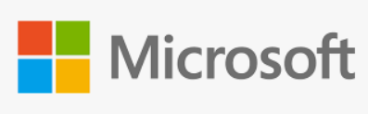
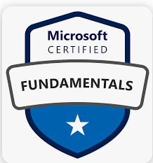
Azure Fundamentals (AZ-900)

Slide 2
Outlines (Day -5)
Azure Network Services
Azure Storage Services
Identity Services

Slide 3
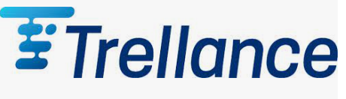
Azure Networking Services
Virtual Network
VPN Gateway
Azure Express Route
Azure DNS
Content Delivery Network (CDN)
© 2023 Trellance, Inc. All rights reserved.
Notes:
https://www.youtube.com/watch?v=inaXkN2UrFE

Slide 4
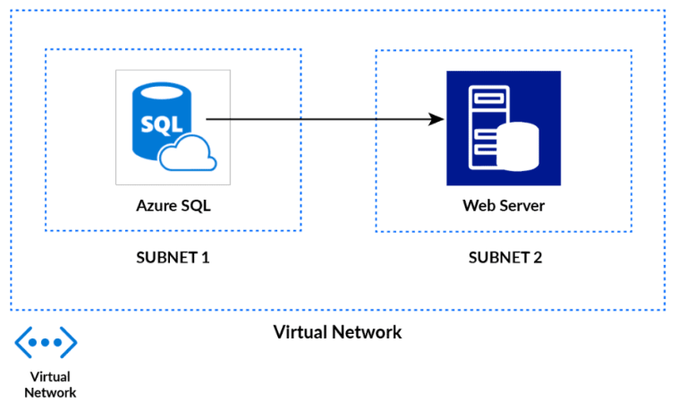
Virtual Network
Represents your network environment virtually to run VMs and applications in the cloud.
When it is created, the services and Virtual Machines within the network interact securely with each other over the internet.
The main purpose of Virtual Networks is to act as a communication channel between resources launched in the cloud.
Notes:
By creating separate VNets for each department,
you can ensure network isolation, enhanced security, and efficient management of resources.
The VNets can also be connected to your on-premises network through Azure VPN Gateway or ExpressRoute, enabling secure communication between the cloud and on-premises infrastructure.

Slide 5
Benefits of VNet
Provides an isolated environment for your application
Internet communication(A Subnet in a VNet can access the public internet by default)
Traffic can be easily filtered from resources
Route network traffic
Communicate with on premises resources
Connect virtual networks (Network peering)
Notes:
https://k21academy.com/microsoft-azure/architect/virtual-networks-in-microsoft-azure-vnet-peeringexpressroutevpn-gateway/
https://www.youtube.com/watch?v=Wb2rAYQ3Qbc&ab_channel=Simplilearn

Slide 6
Components of Azure Virtual Network
1. Subnet : a specific range of IP addresses
2. Routing : the process of directing network traffic from its source to its destination
3. Gateway : network device that serves as an entry or exit point between different networks.
4. Firewall : monitors and controls incoming and outgoing network traffic based on security rules.
5. A network interface is the point of interconnection between a computer and a private or public network
6. Network Security Group (NSG) :
A network security group contains security rules that allow or deny inbound network traffic to, or outbound network traffic from, several types of Azure resources.
Notes:
https://www.testpreptraining.com/blog/what-is-the-difference-between-public-and-private-subnet-in-aws/
A network security group contains security rules that allow or deny inbound network traffic to, or outbound network traffic from, several types of Azure resources. For each rule, you can specify source and destination, port, and protocol
NSG stands for Network Security Group. It is a fundamental network security feature in Microsoft Azure that acts as a virtual firewall for controlling inbound and outbound traffic to Azure resources.
Here's an example of a real-time application of NSGs:
Suppose you are managing a multi-tier web application deployed in Azure that consists of a web server, an application server, and a database server. To secure the communication between these components and control network traffic, you can use NSGs.
By using subnets, you achieve network segmentation, efficient IP address allocation, and improved security within your organization's network infrastructure. Each department has its own subnet, allowing for logical separation, better control over network traffic, and easier management of resources.
Suppose you work for a large organization that has multiple departments, each requiring their own network segment. To achieve network segmentation and efficient IP address allocation, you decide to use subnets.
Here's how subnets can be used in this scenario:
Departmental Network Segmentation: You have departments such as Finance, Marketing, and IT. To separate their network traffic and ensure security and privacy, you create separate subnets for each department. For example, you might create the Finance Subnet, Marketing Subnet, and IT Subnet.
IP Address Allocation: Each subnet is assigned a specific IP address range that is unique within the larger network. For instance, the Finance Subnet may be assigned the IP range 192.168.1.0/24, the Marketing Subnet 192.168.2.0/24, and the IT Subnet 192.168.3.0/24. This allows devices within each subnet to have IP addresses within their respective ranges.
Network Routing: Routers are configured to connect the subnets and enable communication between them. Routing tables are set up to direct network traffic between subnets based on their IP addresses

Slide 7
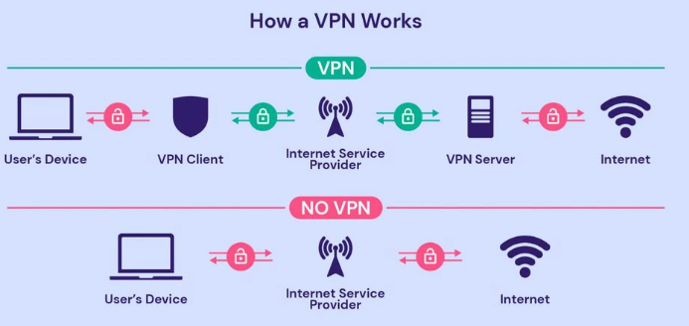
VPN Gateway
A VPN gateway is a specific type of virtual network gateway, which is used to send encrypted traffic between an Azure virtual network and an on-premises location over the public internet.
VPN gateway act as a middleman on both sides of the virtual networks.
And if the workloads in those virtual networks need to communicate with each other, they will communicate via this encrypted channel of communication between the VPN gateways of both virtual networks.
Notes:
A gateway in a network converts information from one protocol to another and then transfers it over the web.
For example, if a computer on the Internet sends an email to another, the gateway converts the message from one protocol to another and sends it back
Suppose you work for a company that has multiple branch offices located in different cities. To provide secure communication and connectivity between these offices, you decide to set up a VPN infrastructure using VPN Gateways.
By deploying VPN Gateways, you can establish secure and private communication channels between different networks. It enables branch offices to securely access resources in the company's headquarters and allows remote users to connect to the corporate network from anywhere, ensuring data confidentiality and integrity.

Slide 8
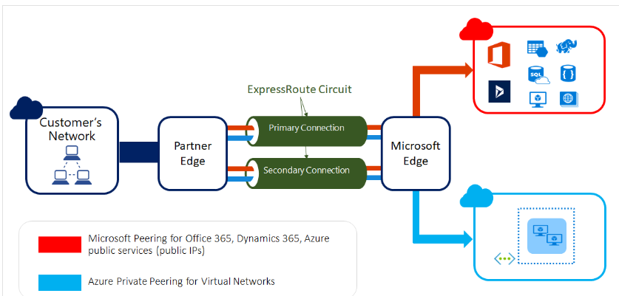
Azure Express Route
Extend your on-premises networks into the Microsoft cloud over a private connection, with the help of a connectivity provider.
Connectivity can be from an any-to-any (IP VPN) network, a point-to-point Ethernet network, or a virtual cross-connection through a connectivity provider at a colocation facility.
ExpressRoute connections don't go over the public Internet.

Slide 9
Azure DNS
Hosting service for DNS domains that provides name resolution by using Azure infrastructure.
Manage DNS records using the same credentials, APIs, tools, and billing as your other Azure services.
Benefits of Azure DNS
Note : You can't use Azure DNS to buy a domain name.
Reliability and performance
Security
Ease of Use
Customizable virtual networks
Alias records
Notes:
DNS stands for Domain Name System. It is a hierarchical decentralized naming system that translates domain names (such as www.example.com) into IP addresses (such as 192.0.2.1). DNS is essential for the functioning of the internet as it enables users to access websites and other internet resources using user-friendly domain names instead of remembering complex IP addresses.

Slide 10
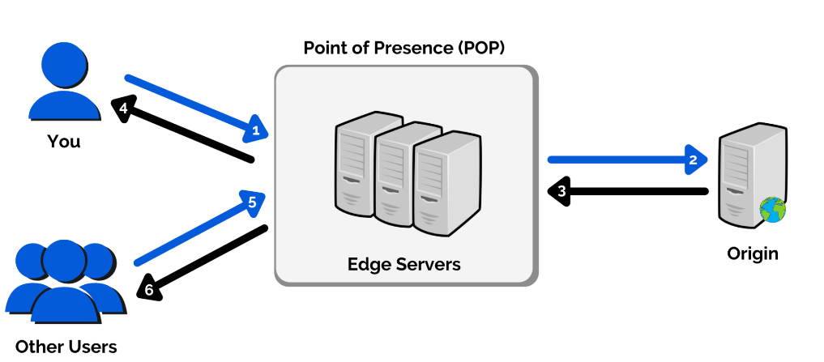
Azure CDN (Content Delivery Network)
CDN is a global solution for organizations to adapt and deliver high bandwidth content.
With the help of Azure CDN, you can prefer to cache static objects that are loaded from a web application or Azure blob storage by using the nearest Point of Presence (POP).
Notes:
https://www.whizlabs.com/blog/azure-cdn-complete-guide/
By using Azure CDN, you can significantly improve the delivery speed and user experience of your website's static content. It reduces latency, optimizes bandwidth usage, and provides a more responsive browsing experience for users around the world.
It's important to note that Azure CDN can also be used to accelerate the delivery of dynamic content, live streaming, and other types of content delivery scenarios
Azure CDN (Content Delivery Network) is a global distributed network of servers that helps deliver high-bandwidth content to users with low latency and high performance. It caches and distributes content across multiple edge locations worldwide, closer to end-users, reducing the distance data needs to travel and improving content delivery speed.
Here's an example of a real-time application of Azure CDN:
Suppose you have a website that serves static content such as images, videos, CSS files, and JavaScript files. To improve the performance and user experience, you decide to leverage Azure CDN.

Slide 11
Azure Storage Services
Different types of data
Storage Accounts
Storage redundancy
Storage services
Azure data migration
Azure file movement

Slide 12
Types of Data
Structured Data
Example : Database tables
Semi Structured Data
Example : XML and Json files
Un Structured Data
Example : Images , PDF ,Videos and Text documents

Slide 13
Storage Account
A storage account provides a unique namespace for your Azure Storage data.
Accessible from anywhere in the world over HTTP or HTTPS.
Data in this account is secure, highly available, durable, and massively scalable.
Data in an Azure Storage account is always replicated three times in the primary region.

Slide 14
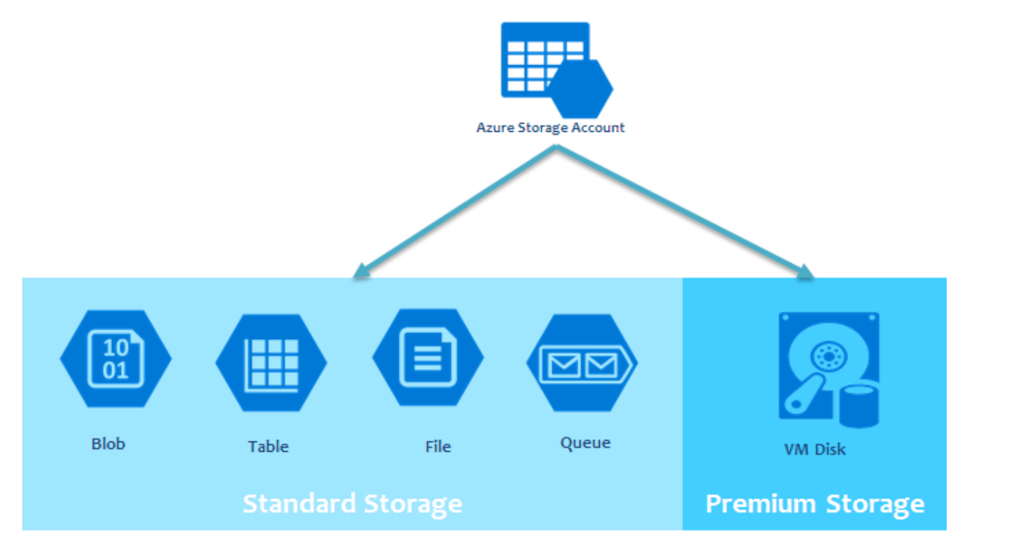
Azure Storage Services
Azure Storage : Stores structured or unstructured data which can be accessed remotely from anywhere.
Blob : Scalable object store for text and binary data , Big data Analytics (ADLS) (unstructured data)
Files : Sharing of files among multiple VMs.
Queue : Messaging store for consistent messaging between application components.
Tables : NoSQL store for schema - less storage of structured data.
Disks : Block level storage volumes for Azure VM

Slide 15
Blob Storage
Serving images or documents directly to a browser.
Storing files for distributed access.
Streaming video and audio.
Storing data for backup and restore, disaster recovery, and archiving.
Storing data for analysis by an on-premises or Azure-hosted service.
Blob Storage Tiers:
1. Hot access tier 2. Cool access tier 3. Archive access tier
( frequently access) (Infrequently access : 30) (rarely accessed : 180)
Notes:
Block blobs are optimized for streaming and storing large amounts of data,
append blobs allow for adding data to the end of an existing blob,
and page blobs are optimized for random read and write operations.

Slide 16
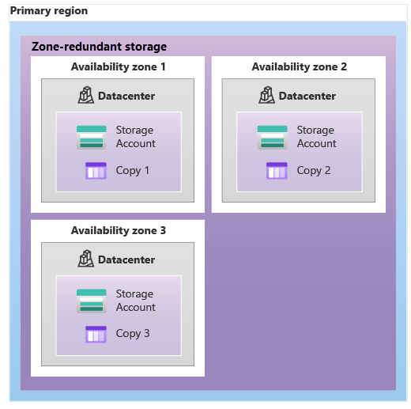
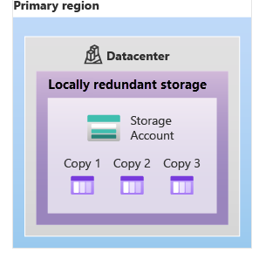
Storage redundancy
Primary region:
Locally redundant storage (LRS) : provides at least 11 nines of durability (99.999999999%) of objects over a given year.
Zone-redundant storage (ZRS) : 12 nines (99.9999999999%) over a given year.

Slide 17
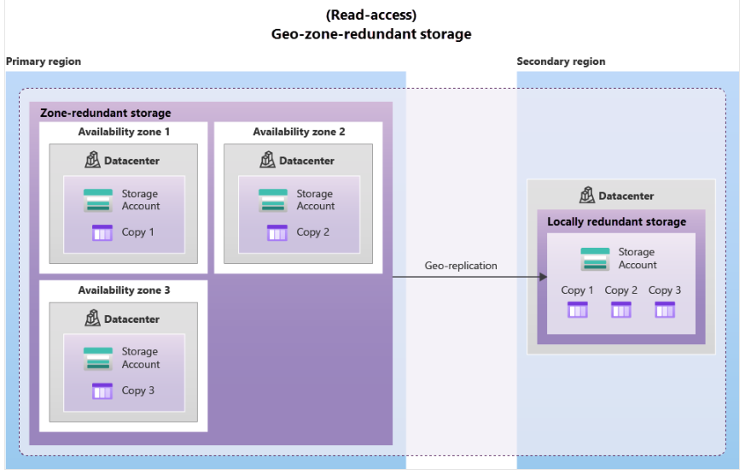
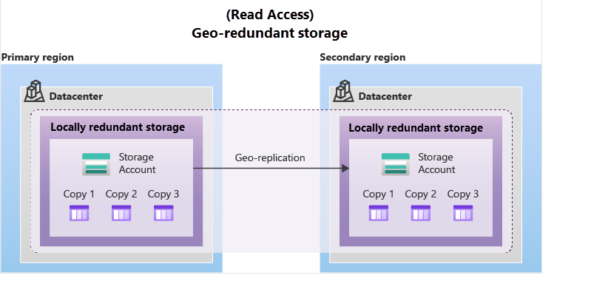
Secondary region
Geo-redundant storage (GRS) : 16 nines (99.99999999999999%) over a given year.
Geo-zone-redundant storage (GZRS) :16 nines (99.99999999999999%) of durability

Slide 18
Azure Data Migration Options
How to get your data and information into Azure.
1.Azure Migrate : real-time migration of infrastructure, applications, and data
2. Integrated Tools : Data Migration Assistant, web app Migration Assistant and Data Box
3.Azure Data Box : physical migration service that helps transfer large amounts of data in a quick, inexpensive, and reliable way.
maximum usable storage capacity of 80 terabytes.
You can order the Data Box device via the Azure portal to import or export data from Azure.
Once the device is received, you can quickly set it up using the local web UI and connect it to your network.
Once you’re finished transferring the data (either into or out of Azure), simply return the Data Box.

Slide 19
Azure File movement options
Azure has tools designed to help you move or interact with individual files or small file groups.
1. AzCopy :
copy blobs or files to or from your storage account.
2. Azure Storage Explorer :
provides a graphical interface to manage files and blobs in your Azure Storage Account.
3. Azure File Sync :
centralize your file shares in Azure Files

Slide 20

Identity Services
Azure Active Directory (AAD)
Authentication and Authorization
Windows Server AD-DS
Azure authentication Methods
Conditional Access
Role Based Access Control (RBAC)
Layers of defense-in-depth
Microsoft Defender for Cloud

Slide 21
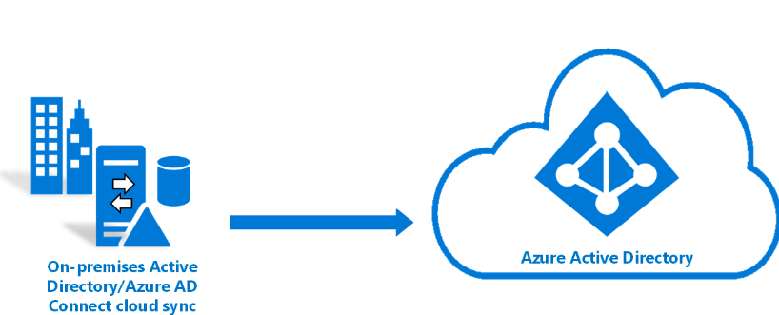
Azure Active Directory
Azure AD is a directory service that enables you to sign in and access both Microsoft cloud applications and cloud applications that you develop.
Microsoft Cloud based identity and access management services
User information such as username, id, email, password and address is stored in Azure AD by organizations
Who uses Azure AD?
(Admins, App developers, Users, Online service
subscribers)
Notes:
By using Azure Active Directory, you can effectively manage user identities, control access to Azure resources, and enhance security within your organization's cloud infrastructure. It streamlines user management, provides a single sign-on experience, and enables secure access to various cloud services.
Suppose you work for a company that has adopted Microsoft Azure as its cloud platform. You decide to leverage Azure Active Directory to manage user accounts and control access to Azure resources.

Slide 22
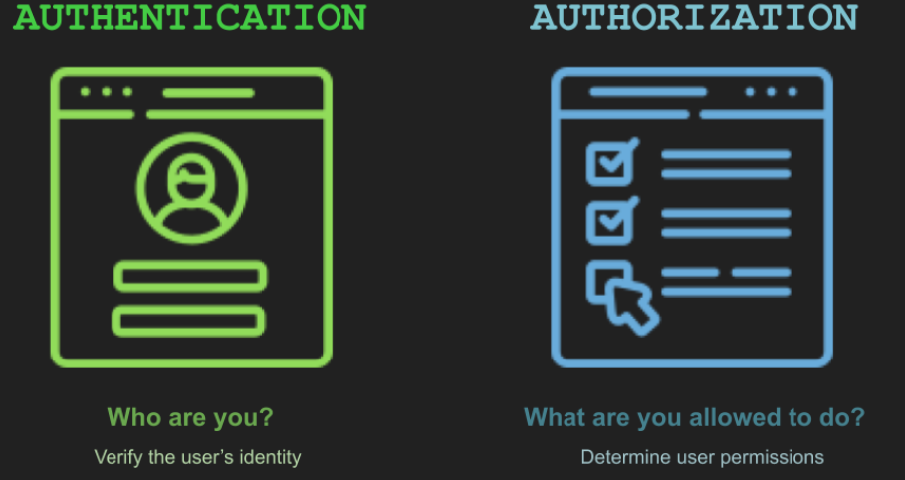
Authentication and Authorization
Authentication is a process for verifying identity
Ex : Valid Username & Password
Authorization gives the user permission to access specific resources.
Ex : Applications, resources, and data

Slide 23
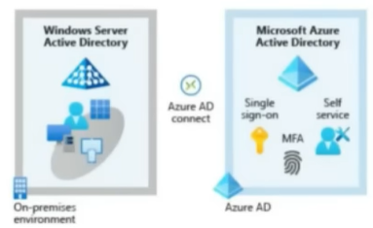
Windows Server AD-DS (Domain Service)
Provides an identity and access management service in on-premises environment.
It uses kerberos based authentication protocol while Azure AD is HTTP/HTTPS based.
Azure AD Connect Synchronizes user identities b/n on-premises AD and Azure AD.

Slide 24
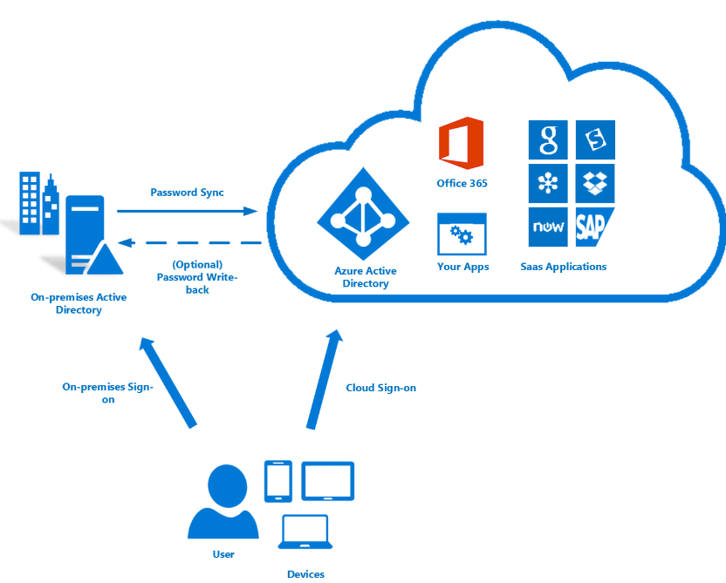
Single sign-on (SSO)
Single sign-on allows users to sign in once and access multiple resources and applications from multiple providers
You need to remember only one ID and one Password.
As users change roles or leave an organization, access is tied to a single identity and so it is easy to manage
Using SSO for accounts makes it easier for users to manage their identities and for IT to manage users.

Slide 25
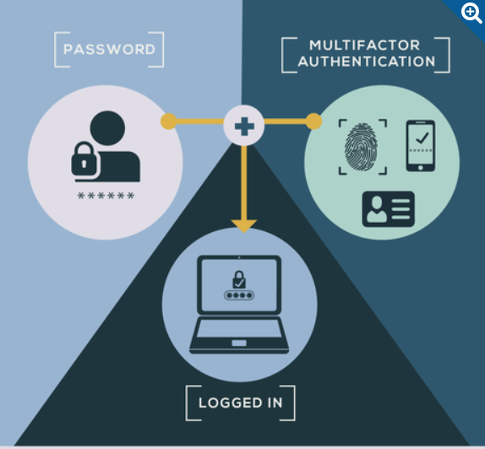
Azure AD Multifactor authentication
An authentication system that requires more than one distinct authentication factor for successful authentication
Something the user knows: Email address and password.
Something the user has : Code that's sent to the user's mobile phone.
Something the User is : Biometric property, such as a fingerprint or face scan.

Slide 26
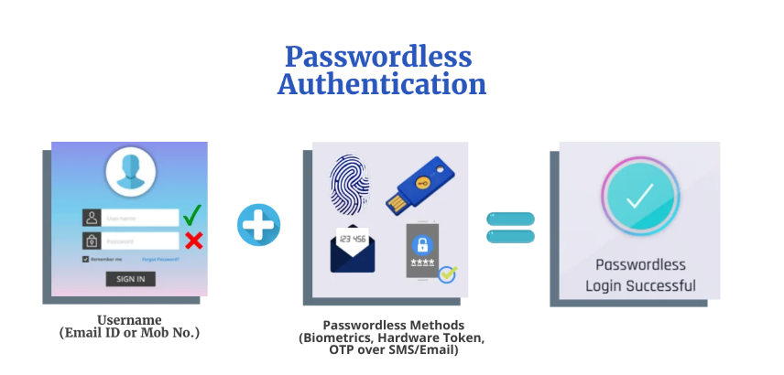
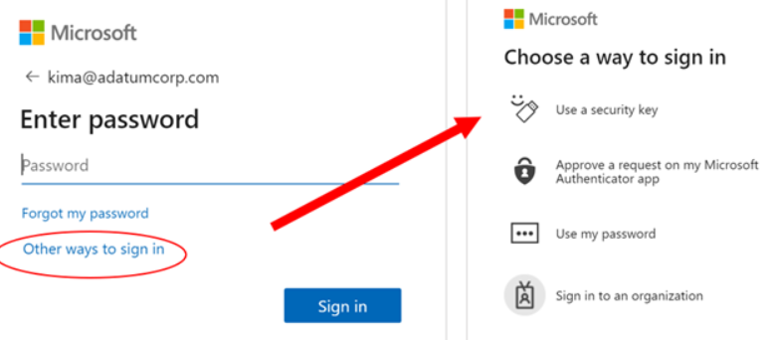
Password less authentication
Way to verify any user’s identity, without asking them to enter a password.
Password less authentication offers a much more secure alternative such as using biometrics like fingerprint/retina scan, emails, push notifications and OTPs.
Example : Microsoft Authenticator

Slide 27
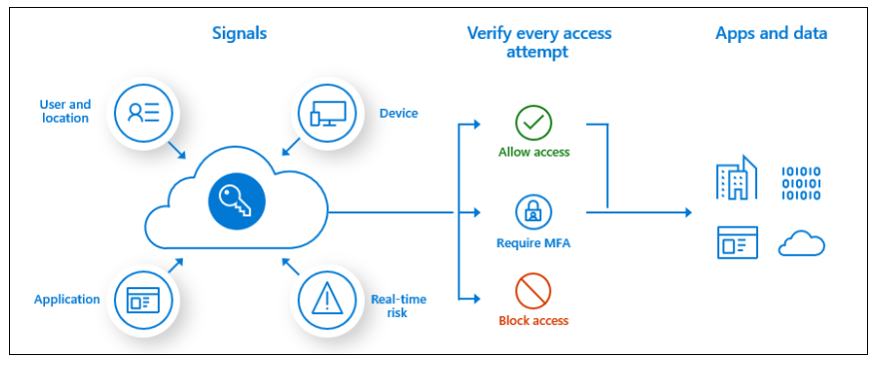
Conditional Access
Based on signals AAD can decide to allow, deny, or require MFA access.
Use Conditional Access policies to apply the right access controls when needed to keep your organization secure.

Slide 28
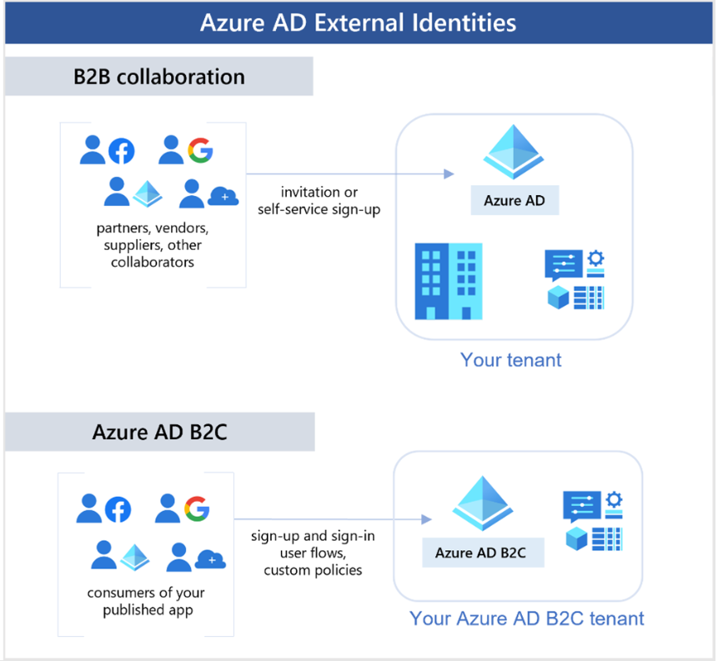
Azure external identities
An external identity is a person, device, service, etc. that is outside your organization.
Azure AD External Identities refers to all the ways you can securely interact with users outside of your organization.
Depending on how you want to interact with external organizations and the types of resources you need to share, you can use a combination of these capabilities

Slide 29
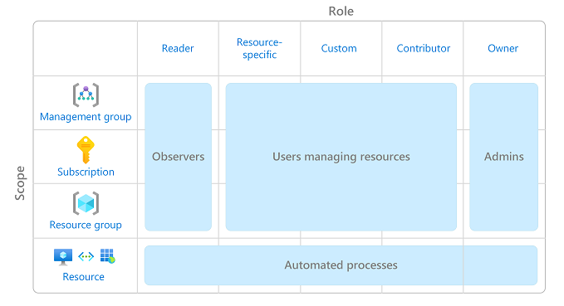
Role Based Access Control (RBAC)
Azure RBAC) is a system that provides fine-grained access management of Azure resources.
Using Azure RBAC, you can segregate duties within your team and grant only the amount of access to users that they need to perform their jobs.
Notes:
Zero trust model
Describe defense-in-depth
Microsoft Defender for Cloud
RBAC (Role based Access Control)
Azure External Identities
Azure Authentication Method
Azure Directory Services
Azure AD - DS

Slide 30
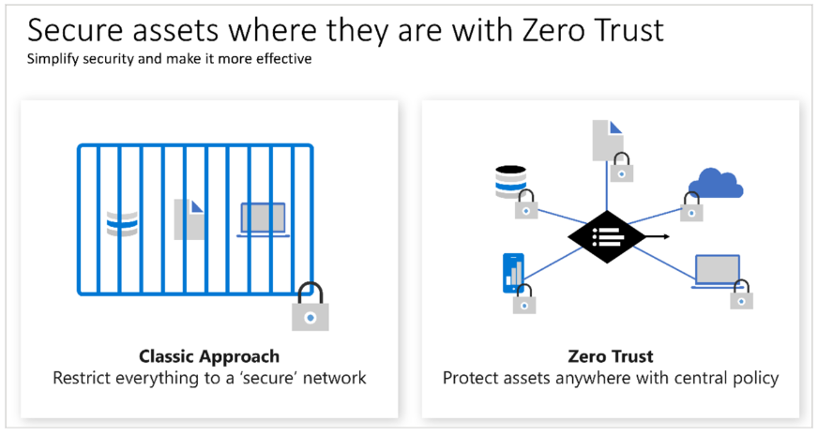
Zero trust model
Microsoft's modern security strategy.
Microsoft has adopted a Zero Trust strategy to secure corporate and customer data.

Slide 31
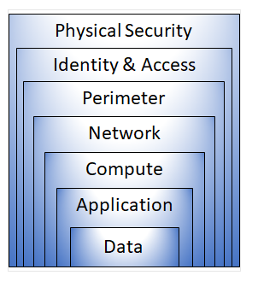
Layers of defense-in-depth
set of layers, with the data to be secured at the center and all the other layers functioning to protect that central data layer.
Each layer provides protection so that if one layer is breached, a subsequent layer is already in place to prevent further exposure.

Slide 32
Quiz Time

Slide 33
Q
A

